Slide 1
You Will Be Hacked: Build to Recover, Not Just to Prevent
Jinhong Brejnholt
Saxo Bank

Slide 2
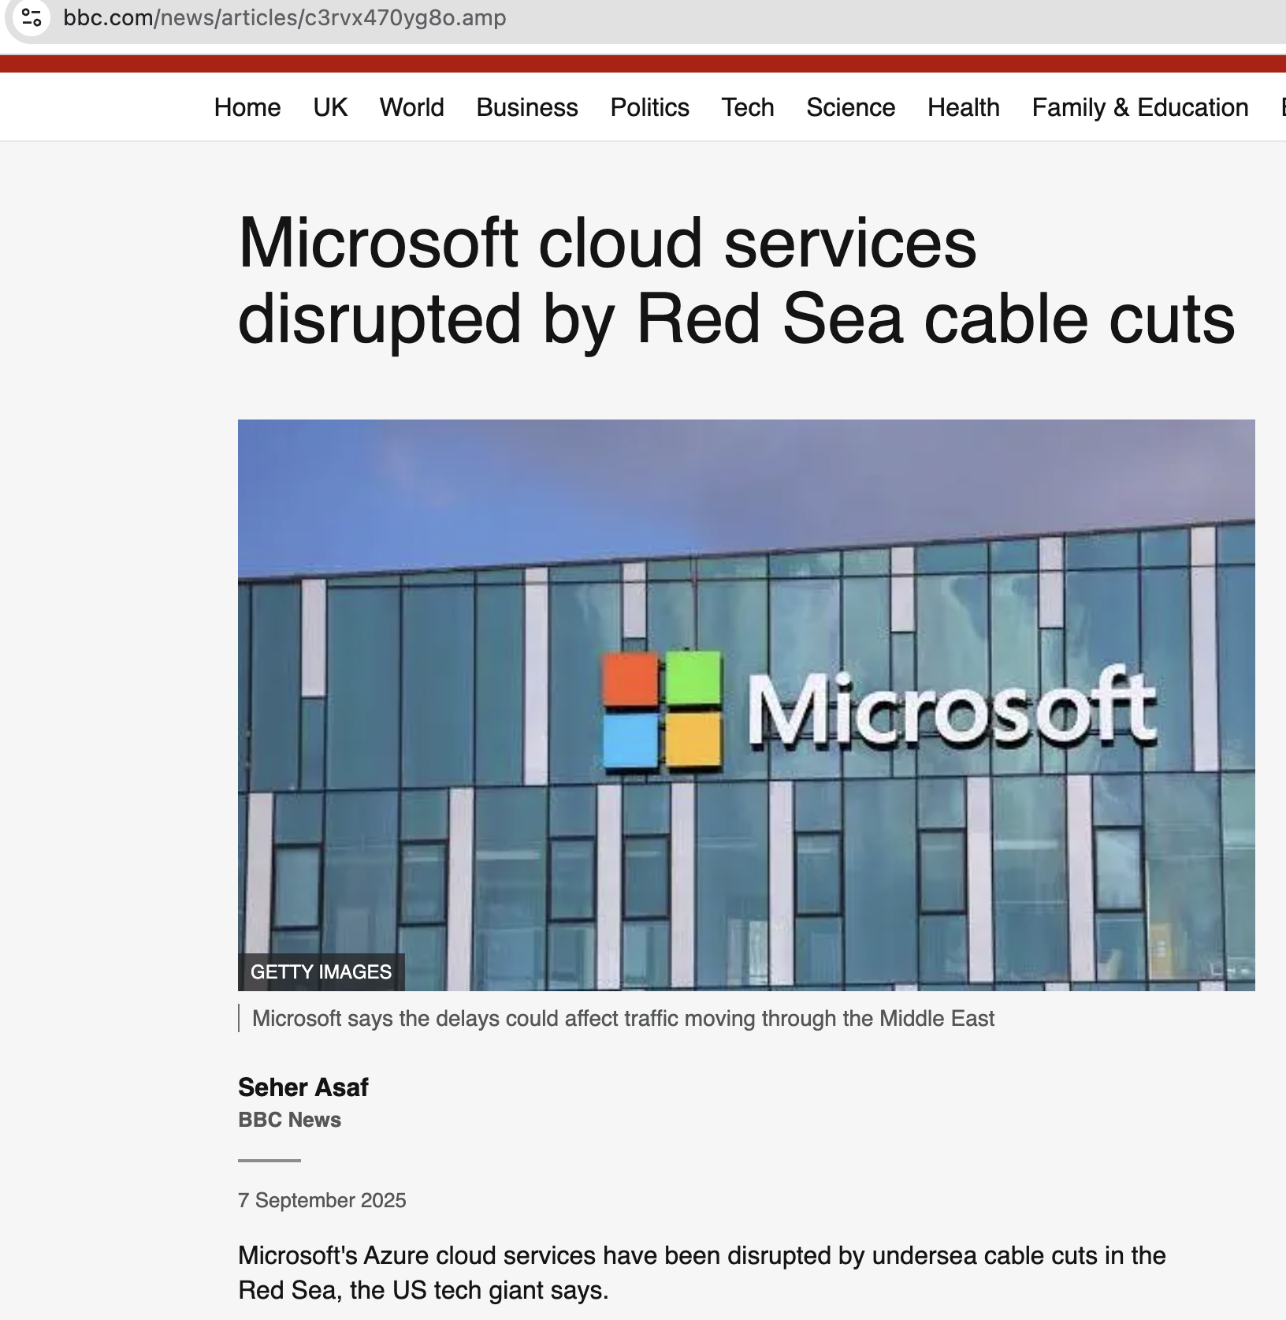

jbrejnholt

Slide 3


About Us
Online trading and investment
$17 billion daily trade
200+ banks and brokers
1.4 million clients
€ 118 billion in client assets
jbrejnholt
Notes:
Saxo Bank is a Danish investment bank specializing in online trading and investment. It was founded as a brokerage firm in 1992, under the name Midas Fondsmæglerselskab, by Lars Seier Christensen, Kim Fournais, and Marc Hauschildt. The name was changed to Saxo when the company obtained a banking license in 2001.
Saxo Bank A/S is a fully licensed and regulated Danish bank with an online trading platform that empowers you to invest across global financial markets.

Slide 4
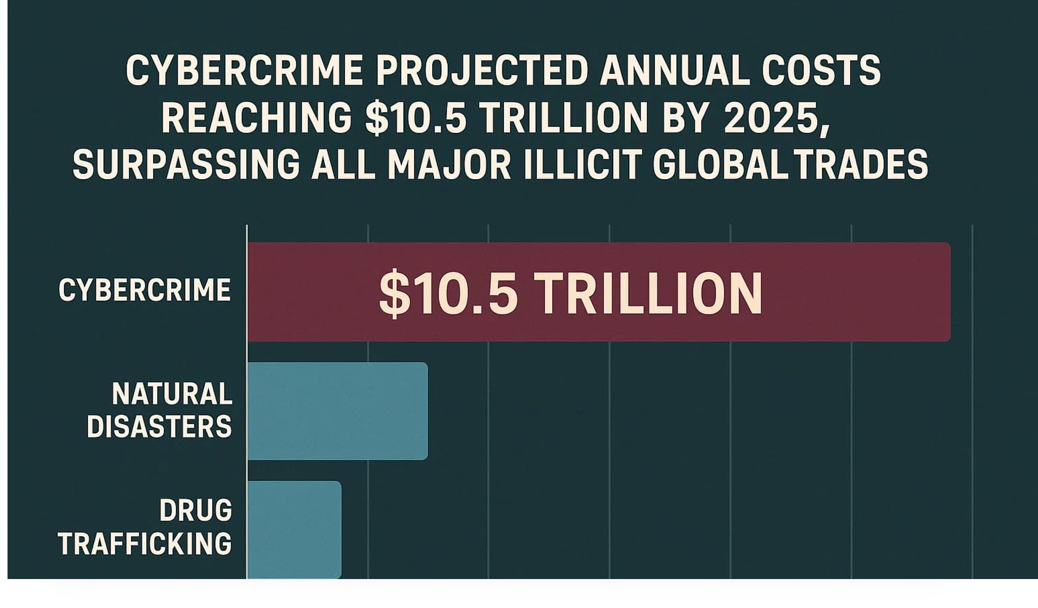
$26 Billion Lost Every Day
>$1 Billion Lost Every Hour

Slide 5

Even the Biggest Get Hit
Marks & Spencer – £300M ransomware loss (Apr 2025)
Allianz – 1.4M customer records stolen (Jul 2025)
Google – Salesforce breach by ShinyHunters (Aug 2025)
jbrejnholt
Notes:
Marks and Spencer plc is a major British multinational retailer
Allianz SE is a German multinational financial services

Slide 6

Once Targeted
jbrejnholt

Slide 7
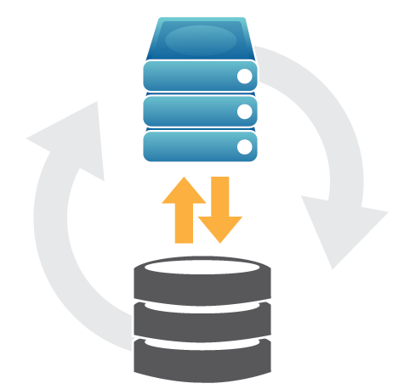
Question
How many of you do backup?
How many of you have tested the restore?
jbrejnholt

Slide 8
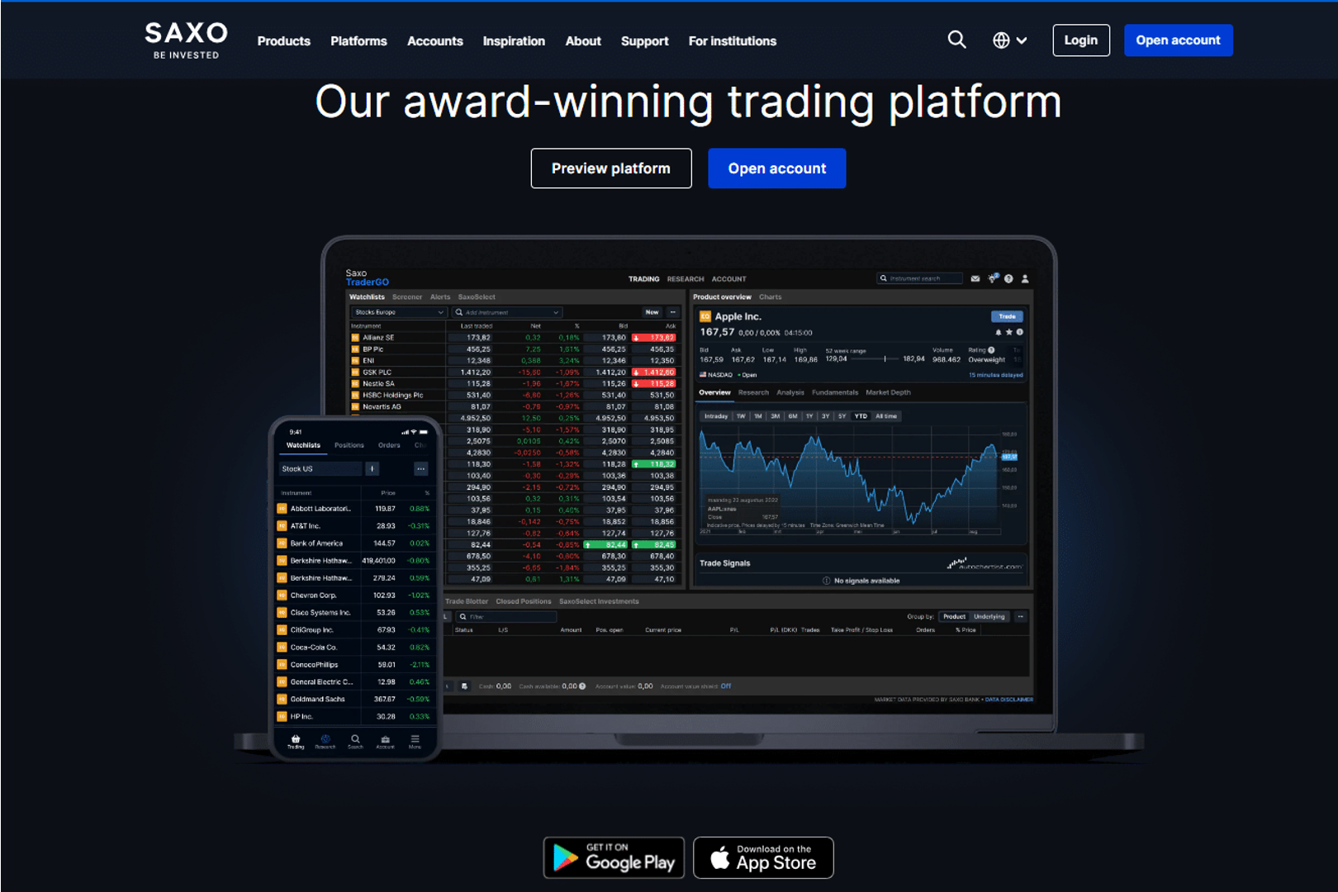
jbrejnholt

Slide 9
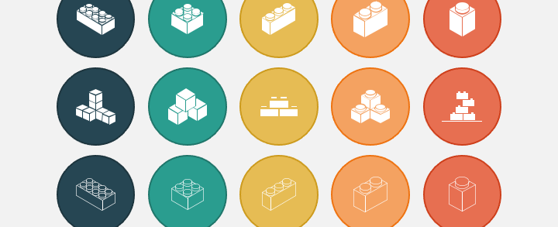
Many Building Blocks
jbrejnholt

Slide 10

Desired State Configuration Done Right
jbrejnholt

Slide 11

Building for Perfect Protection
jbrejnholt
Notes:
You will be hacked. Your data might be stolen. Your systems might go dark. But if you’ve designed for resilience, you’ll recover faster, protect your customers, and emerge stronger. Build to recover — not just to prevent.

Slide 12
Building for Perfect Recovery
jbrejnholt
Notes:
You will be hacked. Your data might be stolen. Your systems might go dark. But if you’ve designed for resilience, you’ll recover faster, protect your customers, and emerge stronger. Build to recover — not just to prevent.

Slide 13


Thank You
jbrejnholt

